Slide 1
Salesforce Configuration Model – 2_2

Slide 2
AGENDA
What is a Flow?
What is Resource?
What is Element?
Types of Flow?
Screen Flow
Autolaunched Flow
Scheduled Flow
Record-Triggered Flow

Slide 3
What is Flow
A flow is an application that can execute logic, interact with the Salesforce database, call apex classes and collect data from users.
It is a drag and drop interface that allows Salesforce user’s to automate business processes
Steps to Create a Flow:
From Setup, enter Flows in the Quick Find box, select Flows, and then click New Flow.
Select the flow type, and click Create.
Drag the elements you want to use onto the canvas.
Connect the elements to determine the order in which they’re executed at run time. Don’t forget to connect the Start element to another element.
Save your flow.

Slide 4
Usage of Flow
Automate a guided visual experience.
Add more functionality for a behind-the-scenes process than is available in Process Builder. Use Flow Builder to build the more complex functionality. Then call the resulting flow from the process.
Start a behind-the-scenes business process:
When a user clicks something, like a button
When a record is created
When a record is updated
When a platform event occurs
At a specified time and frequency
For example, when an opportunity is won, your company wants a renewal opportunity to be created automatically.

Slide 5
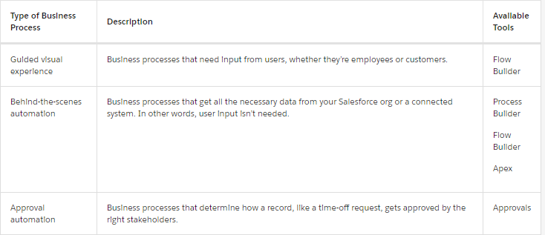
Which Automation Tool Is Right for My Use Case?
When it’s all said and done, a process-driven experience isn’t backed by only one process. It’s a combination of all the business processes in your org that can impact your customer. Each business process typically falls into one of these camps.

Slide 6
Which Automation Tool Is Right for My Use Case?
Outbound message – Workflow/Flow (new feature winter 22)
Available as core action in flow for record triggered flow
- Create Outbound Message on an Object, say Account
- Create record trigger flow optimized for Actions and Related Records for object selected in previous step
Add action from Elements (Interaction)
Now, Outbound Message is available in core action

Slide 7
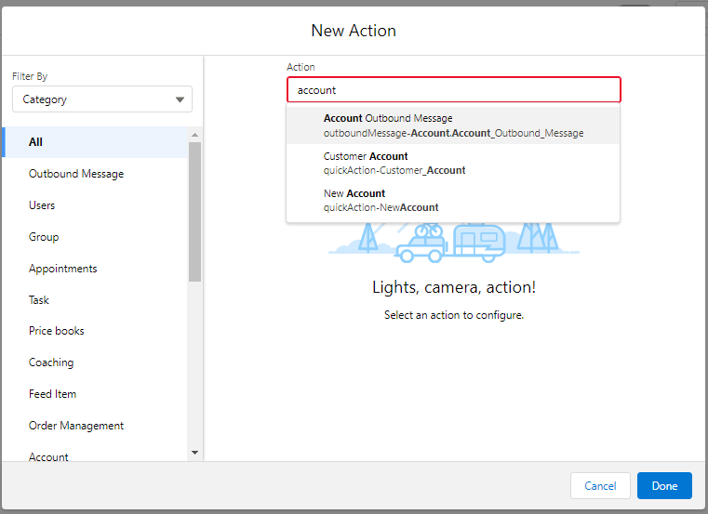
Which Automation Tool Is Right for My Use Case?

Slide 8
Resources
Each resource represents a value that you can reference throughout the flow.
Steps to Create Resource
In Flow Builder, the Manager tab displays the resources that are available in the flow.
You can create some resources by clicking New Resource. Some resources, such as global constants and global variables, are provided by the system.
Other resources are created when you add an element to a flow.
For example, when you add a Decision element, a resource for each decision outcome is created.

Slide 9
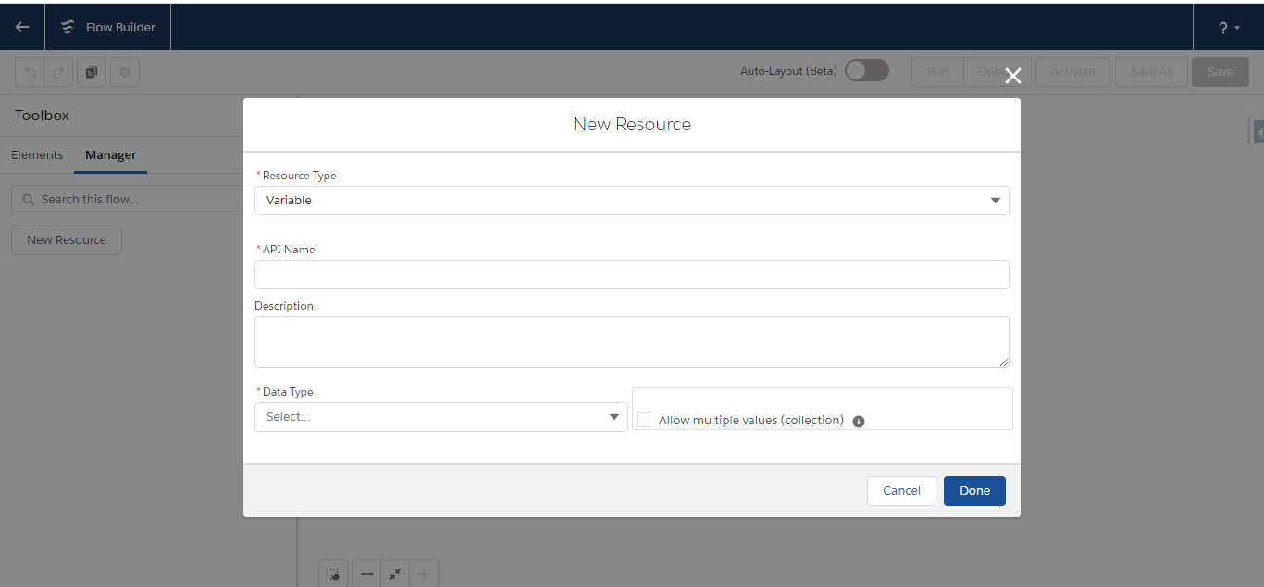
Resources

Slide 10
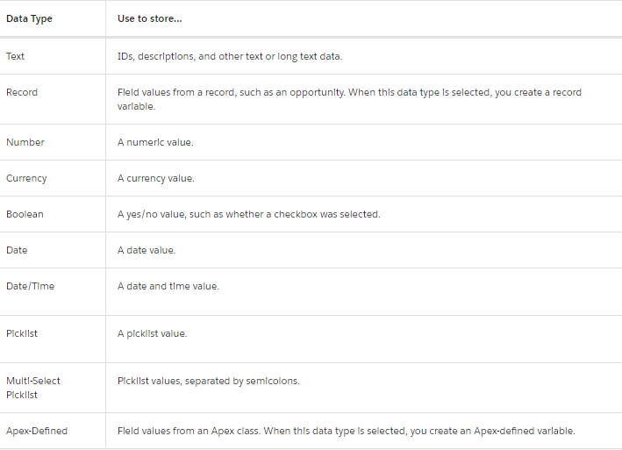
Types of Resources

Slide 11
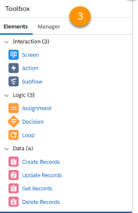
Toolbox Elements
Each element represents an action that the flow can execute.
In Flow Builder, the Elements tab displays the types of elements that you can add to the flow by dragging them onto the canvas
Types Of Elements:
Screen: Used in Screen flow to get inputs or to display some data to the user
Action: Used to perform some action like calling a apex class
Subflow: to call another Flow
Assignment: Like “=“ operator used in coding
Decision: Like “If:Else” Statement used in coding
Loop: Used for Looping purpose
Data Section: Used to perform DML operation like creating a record, updating and deleting a record
Get Records: It is used to fetch data from database

Slide 12
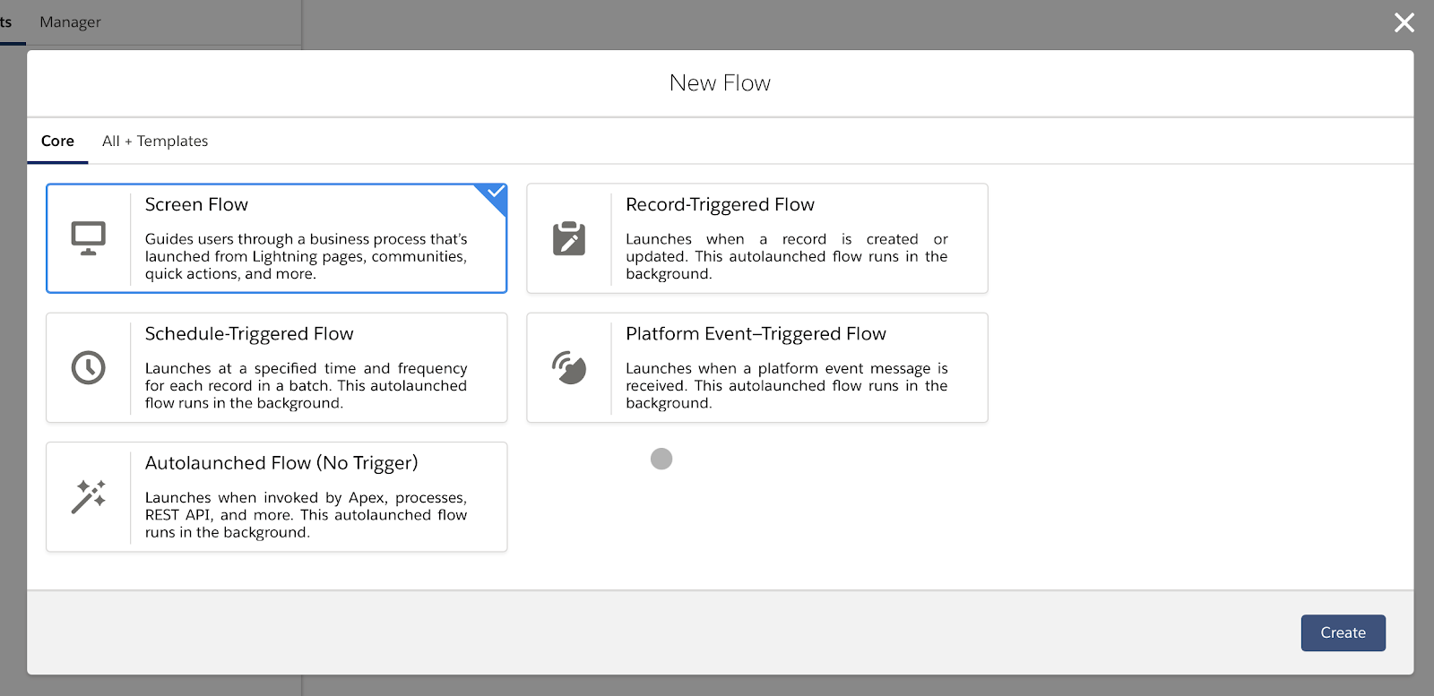
Types of Flow

Slide 13
Screen Flow
Requires user interaction because it includes screens, local actions, steps, choices, or dynamic choices. Screen flows don’t support Pause elements.
Just as you configure the user experience of your record pages in Lightning App Builder, you use screens to do the same for your flow users.
Each screen is made up of one or more screen components. A screen component is a configurable, reusable element added to a screen.
Screen components are available in three categories.
Input includes standard components that request information from the user.
Display includes standard components that display information to the user.
Custom includes components that you or someone else have created. Install them from AppExchange or a third-party library, or work with a developer to build your own.

Slide 14
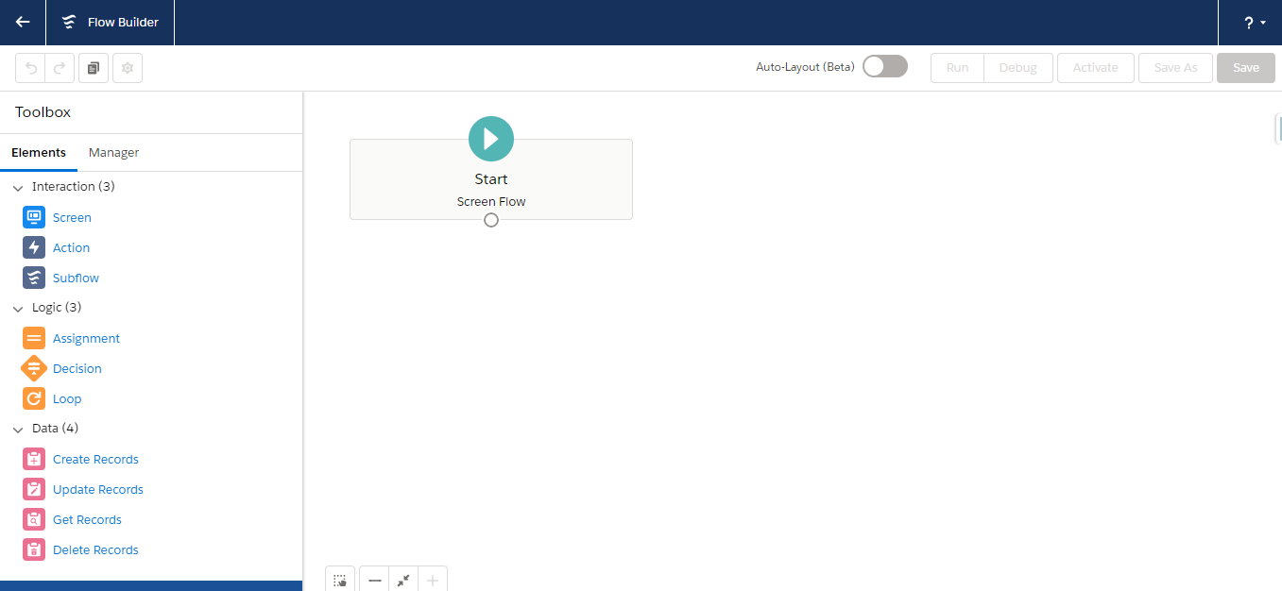
Screen Flow Builder

Slide 15
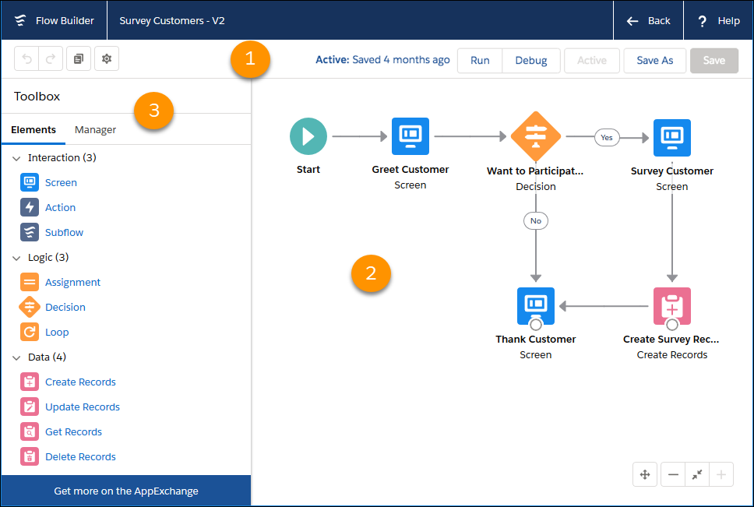
Screen Flow
Each Flow should start with a start element
Each elements can be then dragged and dropped to the canvas and should be connected with each other in order to define the sequence or execution

Slide 16
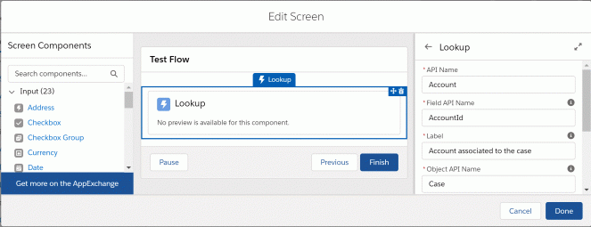
Screen Component
The most common element without which the screen flow is incomplete is the Screen Component which the help of which we can get the inputs from the user or can display some data

Slide 17
DML in Screen Flow
Create Record
Update Record
Delete Record
Get Records
Rollback

Slide 18
Methods to invoke a Screen Flow
Flow actions
Lightning pages
Lightning community pages
Custom Aura components
Custom Lightning web components
Custom buttons or custom links
Web tabs
Direct flow URLs
Visualforce pages
Lightning Out
Embedded Service deployments

Slide 19
Auto Launched Flow
Unlike Screen flow which requires user interaction, Auto Launched Flow Doesn’t require user interaction.
It is invoked automatically in background through either of the below ways:
This flow type doesn’t support screens, local actions, choices, or choice sets.
Processes Custom Apex classes REST API Web tabs Custom buttons or custom links Visualforce pages

Slide 20
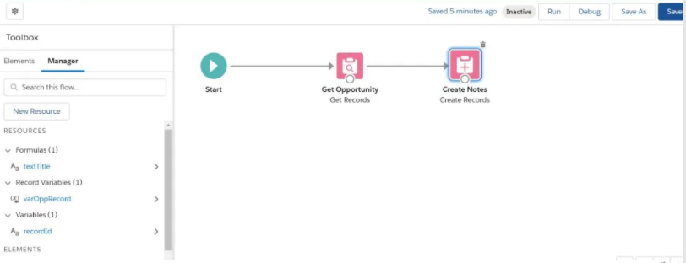
Example of Auto Launched Flow
Like Screen Flow, an auto launched flow should have a start elements and each elements should be connected with each other to define the sequence of execution

Slide 21
Schedule Flow
Schedule an autolaunched flow to start at a specific time and set it to run once, daily, or weekly. To have the scheduled flow run for a batch of records, specify the object and the filter conditions that each record must meet.
A flow interview runs for each record in the batch and stores all of the record’s field values in the $Record global variable. As you build the scheduled flow, reference the $Record global variable to access the record’s field values.
If you configure an Update Records element to use the ID and all field values from the $Record global variable, enable Filter inaccessible fields from flow requests in your org’s process automation settings. Otherwise, the flow fails because the Update Records element tries to set the values for system fields and other read-only fields.
You can monitor scheduled flows from the Scheduled Jobs page in Setup.

Slide 22
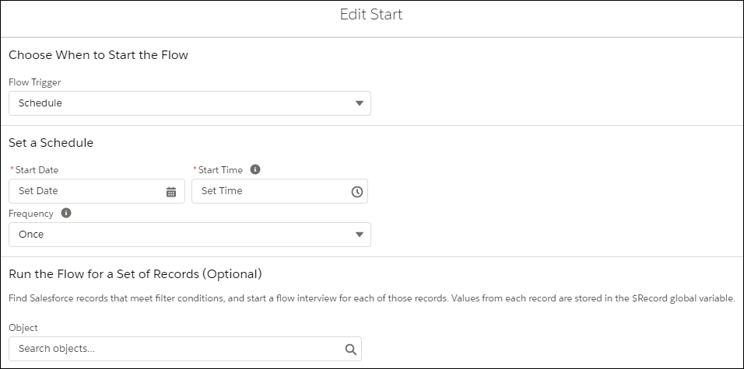
Schedule Flow

Slide 23
Record Triggered Flow
Makes before-save or after-save updates to the new or changed record that launches the flow.
A record-triggered flow runs when a record is created , updated or deleted
Types of Record-Triggered Flow
Before-Save
After-Save

Slide 24
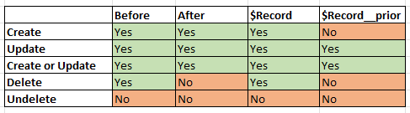
Record Triggered Flow

Slide 25
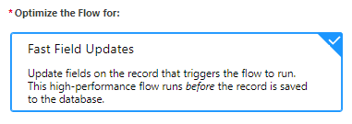
Before Save Flow
Creating or updating a record can trigger a Before Save autolaunched flow to make additional updates to that record before it's saved to the database.
A record-triggered flow can update a Salesforce record 10 times faster than a record-change process.
Configure the record trigger in the Start element of your autolaunched flow.

Slide 26
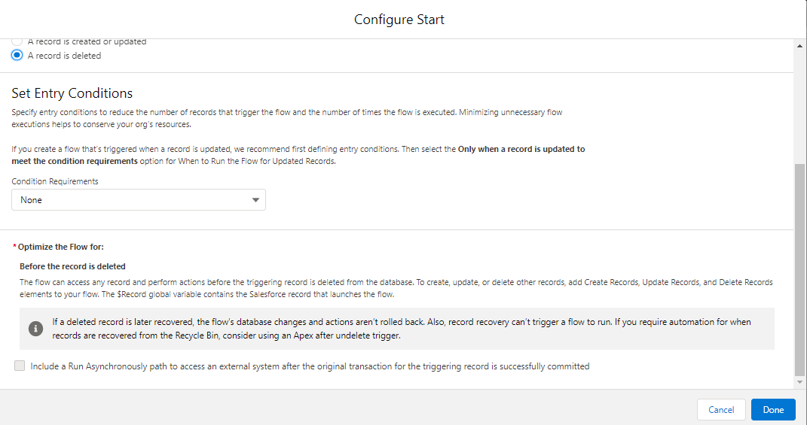
Before Save Flow
Deleting a record can trigger a Before Save autolaunched in case we want to make any changes after the record is deleted

Slide 27
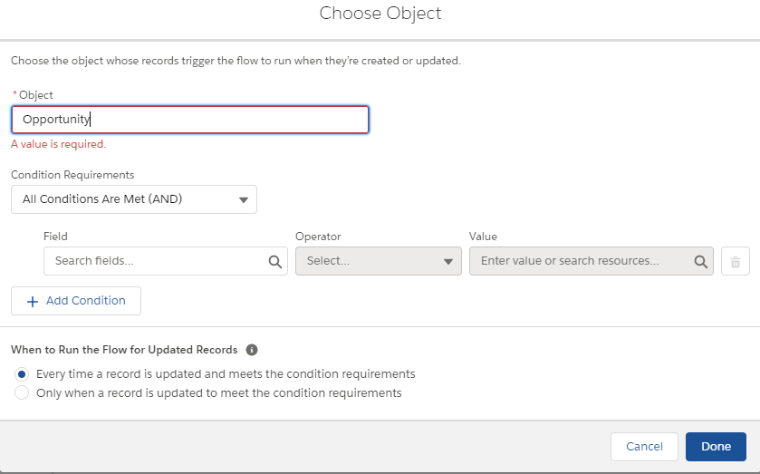
Before Save Flow
Select the object and the Criteria based on which the flow should be triggered

Slide 28
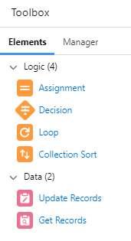
Before Save Flow
Only 6 below elements are present in Before Save Flow:
Assignment
Decision
Loop
Collection Sort
Get Records
Update Records

Slide 29
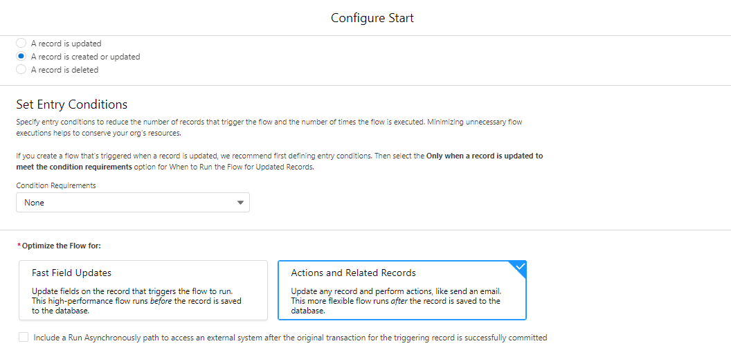
After Save Flow
Similar to Before Save flow, Creating or Updating a record can trigger a After-Save autolaunched flow to make additional updates to that record but only after it's saved to the database.
Configure the record trigger in the Start element of your autolaunched flow.

Slide 30
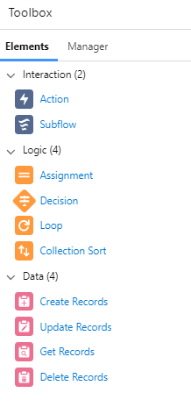
After Save Flow
After Save Flow supports more elements as compared to the Before Save Autolaunched Flow.
In After Save Autolaunched Flow, we can create or update the records as well which is not possible in Before-Save Flow

Slide 31
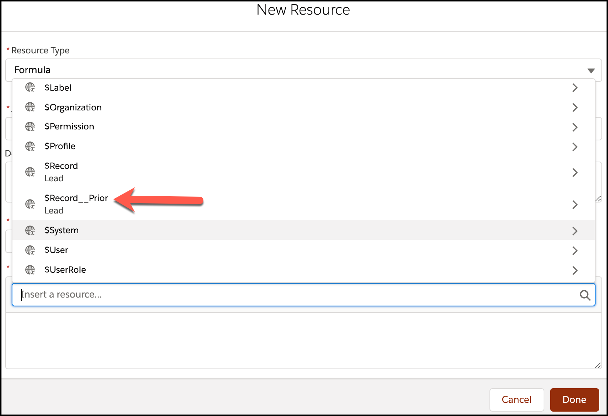
Accessing Prior value

Slide 32
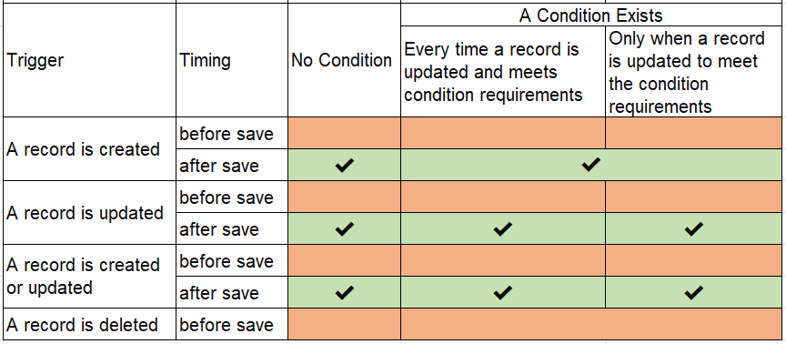
Scheduled Path in Record Triggered Flow
Trigger certain types of events based on date fields on the object that triggered the flow

Slide 33
Thank You

